Slide 1
Call for Projects
2026-2027
www.gw4biomed.ac.uk

Slide 2
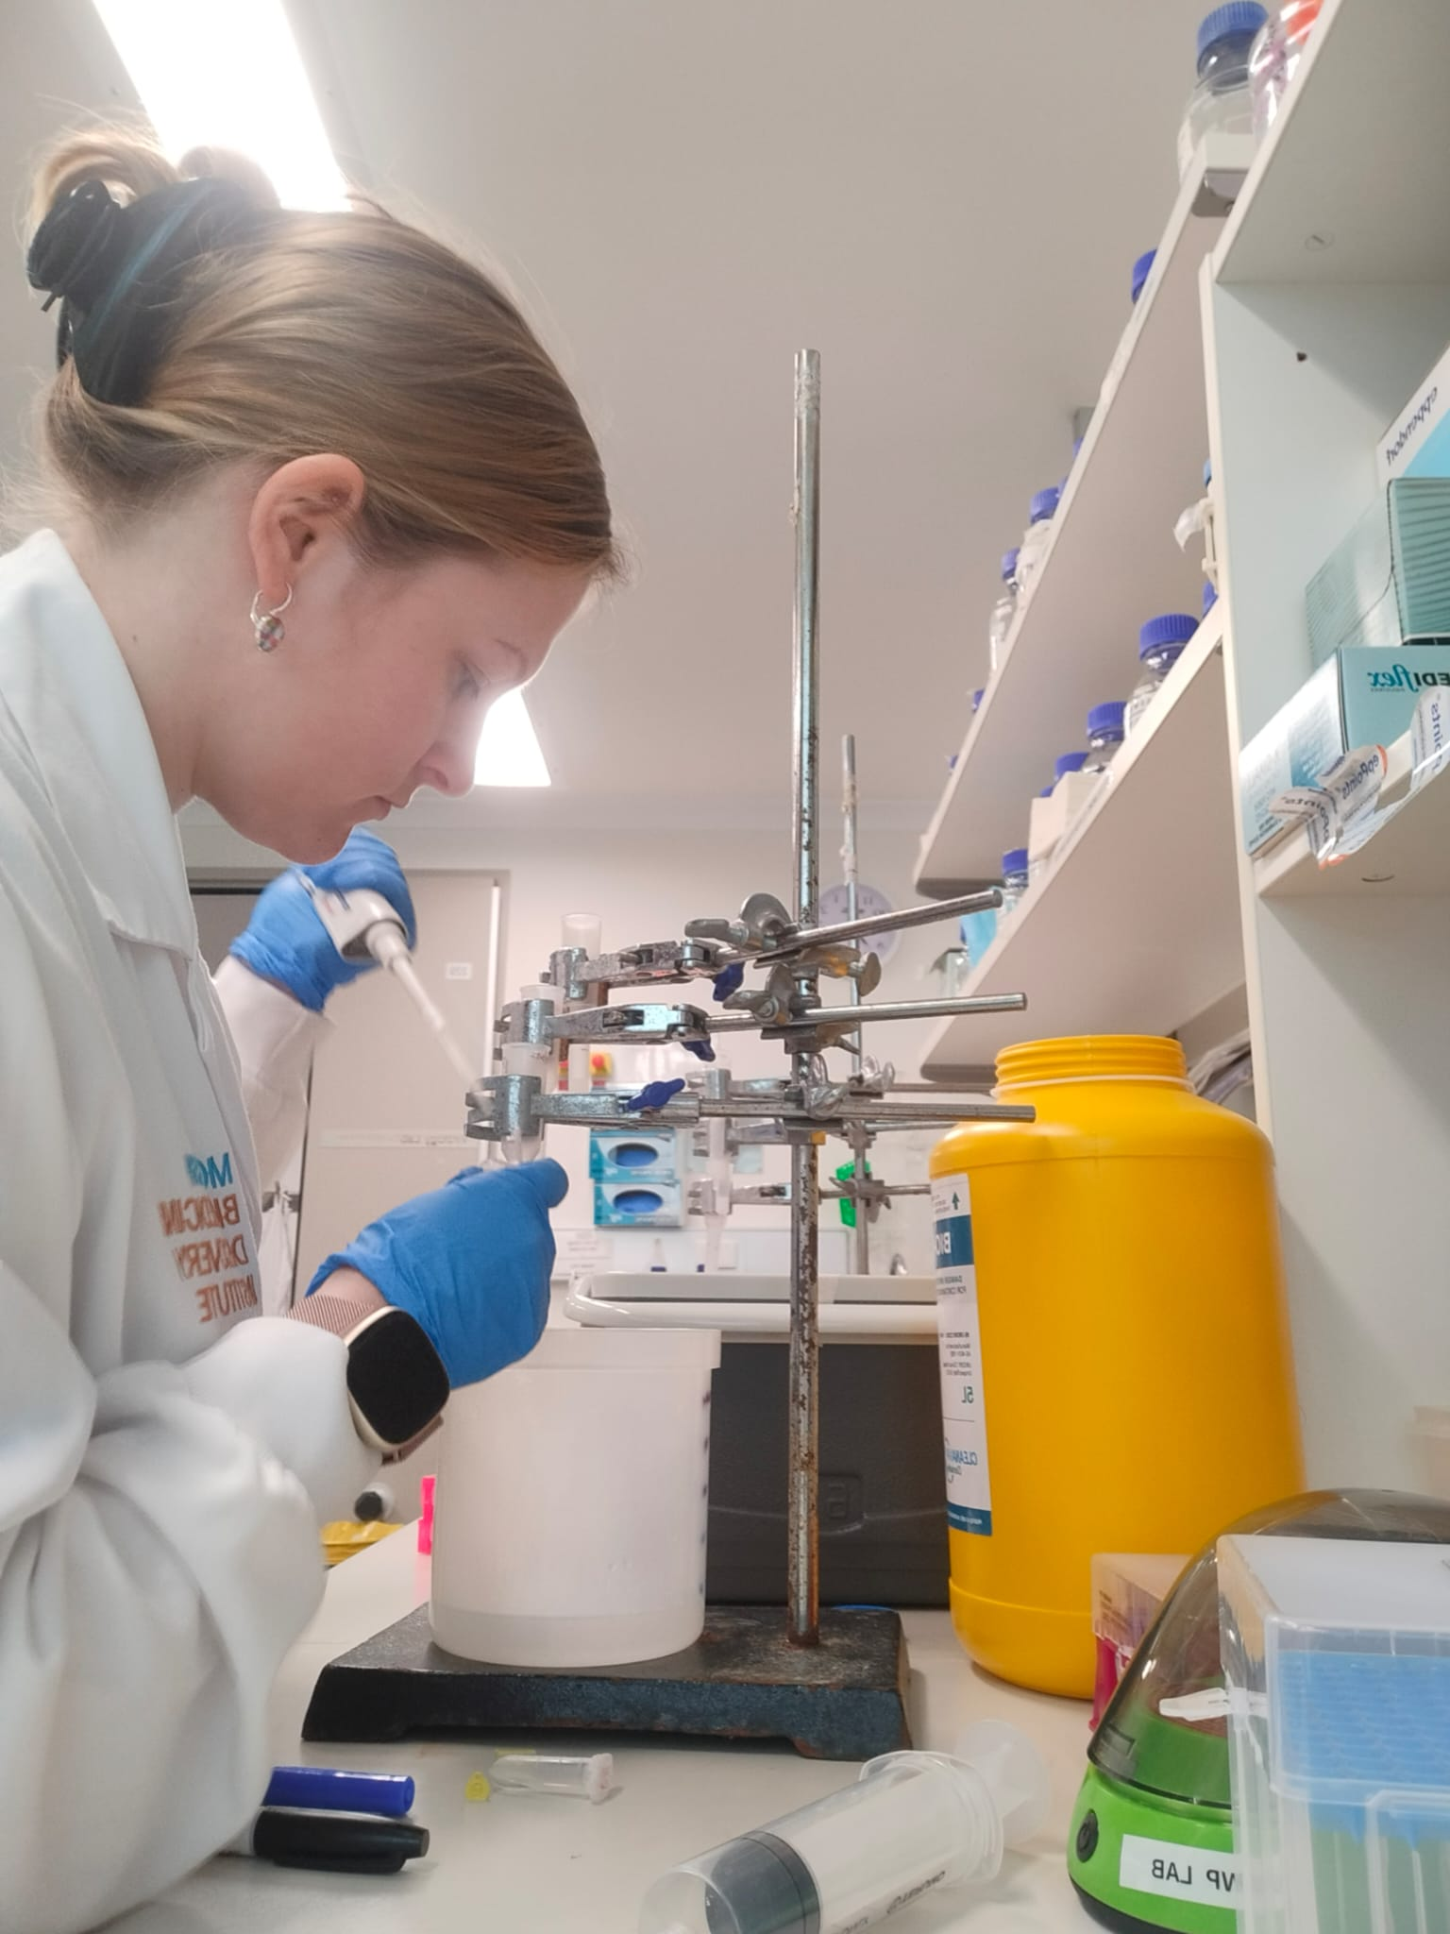
Overview
Background
Our training programme
Our cohorts
The ‘Prep Period’
Funding
Recruitment for 2026-27

Slide 3
The Award
The Award
3 students recruited in AI & Data Science call in 2018
63
studentships allocated
3 initial intakes beginning 2016-17
BioMed1
Awarded additional 3 intakes for 2019-20, 2020-21 and 2021-22
44
studentships allocated
BioMed2 intake of 60 students in first 3 years, Oct 22, 23, 24
Appointed 18 students for Oct 25 start
Awarded additional 2 intakes for Oct 25 and Oct 26
BioMed2
Awarded funding for GW4 BioMed2, 3 intakes starting in October 2022.

Slide 4
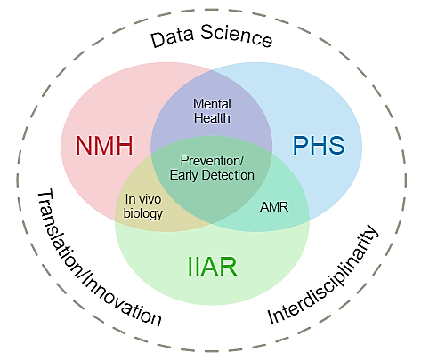
Collaborative Research Excellence

Slide 5
Our Vision
Attract excellent students with research potential and motivation from a broad range of disciplines
Provide training for all including in translation/innovation and data science
Develop graduates for whom collaboration and interdisciplinarity are the norm
Produce doctoral graduates prepared to work collaboratively within and across academia and industry
Over 90% of projects involve more than one GW4 partner
Over 90% of students trained in MRC priority skills

Slide 6
Governance & Management
Our 4-Year Doctoral Education Journey
Prep Period
PhD Starts
Year 1
Year 2
Placement
Year 3
Thesis
Year 4
Notes:
GW4 Board reports to the 4 ROs.
Leadership Team:
4 RO leads and 3 Theme leads
Dr Tom Freeman – Bath Academic Lead
Prof Paul Martin / Prof David Sheppard – Joint Bristol Academic Leads
Dr Emma Kidd – Cardiff Academic Lead
Prof Tim Frayling – Exeter Academic Lead
Prof Anthony Isles (Cardiff) - Neuroscience and Mental Health Theme Lead
Prof Phil Taylor (Cardiff) - Infection, Immunity and Repair Theme Lead
Prof Kate Tilling (Bristol) – Population Health Theme Lead
Management Board:
Executive Director (Chair)
Director
Leadership Team
MRC Unit/Centre representatives
GW4 BioMed Manager
2 student reps
Accountable to MRC, GW4 board (DVC/PVC of each HEI)
Scientific quality
Selection/allocation of projects/students
Oversight of all MRC students
Scientific Advisory Board:
3-4 External advisors
Scientific strategy
Feedback on international best practice
Interact at student congress
Operations Board:
GW4 BioMed Manager (Chair)
GW4 BioMed Administrator
RO professional services reps
Interaction with RO student offices
Supporting recruitment, selection, induction processes
Cohort building activities
Consistency and sharing best practice
Financial management
Student Voice:
2 reps on the board
Annual Congress will include a full student assembly meeting
Each HEI Academic Lead is responsible for liaison with supervisors and other PGR colleagues to ensure academic and partnership procedures and policies are adhered to. This helps ensure that there are clear lines of communications between the students and supervisors and the management/operations teams. This facilitates local autonomy in managing institutional processes, especially around pastoral care and quality, whilst ensuring consistency and cohesiveness across the alliance.

Slide 7
Governance & Management
Governance and Management
Management Board
Chair Prof Colin Dayan
Director Prof Emma Kidd
Leadership Team
8 Joint RO Academic Leads
6 Joint Theme Leads
5 Cross-cutting Theme Leads
Director of Well-being & Research Culture
4 Student representatives
GW4 BioMed MRC DTP Centre Manager
Scientific Advisory Board
Operations Board
PGR Supervisors & Deans
PGR Student Community
Notes:
GW4 Board reports to the 4 ROs.
Leadership Team:
4 RO leads and 3 Theme leads
Dr Tom Freeman – Bath Academic Lead
Prof Paul Martin / Prof David Sheppard – Joint Bristol Academic Leads
Dr Emma Kidd – Cardiff Academic Lead
Prof Tim Frayling – Exeter Academic Lead
Prof Anthony Isles (Cardiff) - Neuroscience and Mental Health Theme Lead
Prof Phil Taylor (Cardiff) - Infection, Immunity and Repair Theme Lead
Prof Kate Tilling (Bristol) – Population Health Theme Lead
Management Board:
Executive Director (Chair)
Director
Leadership Team
MRC Unit/Centre representatives
GW4 BioMed Manager
2 student reps
Accountable to MRC, GW4 board (DVC/PVC of each HEI)
Scientific quality
Selection/allocation of projects/students
Oversight of all MRC students
Scientific Advisory Board:
3-4 External advisors
Scientific strategy
Feedback on international best practice
Interact at student congress
Operations Board:
GW4 BioMed Manager (Chair)
GW4 BioMed Administrator
RO professional services reps
Interaction with RO student offices
Supporting recruitment, selection, induction processes
Cohort building activities
Consistency and sharing best practice
Financial management
Student Voice:
2 reps on the board
Annual Congress will include a full student assembly meeting
Each HEI Academic Lead is responsible for liaison with supervisors and other PGR colleagues to ensure academic and partnership procedures and policies are adhered to. This helps ensure that there are clear lines of communications between the students and supervisors and the management/operations teams. This facilitates local autonomy in managing institutional processes, especially around pastoral care and quality, whilst ensuring consistency and cohesiveness across the alliance.

Slide 8
Governance & Management
Research and Training Themes
Neuroscience and Mental Health (NMH)
Infection, Immunity, Antimicrobial Resistance & Repair (IIAR)
Population Health Sciences (PHS)
Data Science - Priority Area
Interdisciplinary skills - Training Theme
Translation and Innovation - Training Theme
In vivo skills - Training Theme
Reproducibility and Research Integrity - Training Theme
Notes:
GW4 Board reports to the 4 ROs.
Leadership Team:
4 RO leads and 3 Theme leads
Dr Tom Freeman – Bath Academic Lead
Prof Paul Martin / Prof David Sheppard – Joint Bristol Academic Leads
Dr Emma Kidd – Cardiff Academic Lead
Prof Tim Frayling – Exeter Academic Lead
Prof Anthony Isles (Cardiff) - Neuroscience and Mental Health Theme Lead
Prof Phil Taylor (Cardiff) - Infection, Immunity and Repair Theme Lead
Prof Kate Tilling (Bristol) – Population Health Theme Lead
Management Board:
Executive Director (Chair)
Director
Leadership Team
MRC Unit/Centre representatives
GW4 BioMed Manager
2 student reps
Accountable to MRC, GW4 board (DVC/PVC of each HEI)
Scientific quality
Selection/allocation of projects/students
Oversight of all MRC students
Scientific Advisory Board:
3-4 External advisors
Scientific strategy
Feedback on international best practice
Interact at student congress
Operations Board:
GW4 BioMed Manager (Chair)
GW4 BioMed Administrator
RO professional services reps
Interaction with RO student offices
Supporting recruitment, selection, induction processes
Cohort building activities
Consistency and sharing best practice
Financial management
Student Voice:
2 reps on the board
Annual Congress will include a full student assembly meeting
Each HEI Academic Lead is responsible for liaison with supervisors and other PGR colleagues to ensure academic and partnership procedures and policies are adhered to. This helps ensure that there are clear lines of communications between the students and supervisors and the management/operations teams. This facilitates local autonomy in managing institutional processes, especially around pastoral care and quality, whilst ensuring consistency and cohesiveness across the alliance.

Slide 9
 | 16 | 17 | 18 | 19 | 20 | 21 | 22 | 23 | 24 | 25
Proposed projects | 120 | 109 | 121 | 142 | 173 | 144 | 146 | 112 | 125 | 144
Project advertised | 45 | 51 | 71 | 69 | 88 | 86 | 80 | 84 | 108 | 121
Applications received | 251 | 280 | 492 | 437 | 534 | 913 | 948 | 1056 | 1621 | 2421
Interviewed | 39 | 43 | 34 | 52 | 57 | 56 | 50 | 50 | 59 | 55
Studentships awarded | 16 | 26 | 21 | 15 | 18 | 11 | 20 | 19 | 23 | 18
Our Cohorts
18 studentships were available for the 2025-26 intake, including one CASE studentship
Up to 30% of our studentships can be allocated to International applicants.
 | Bath | Bristol | Cardiff | Exeter | Total
Infection, Immunity, Antimicrobial Resistance & Repair | 10 | 20 | 24 | 16 | 70
Neuroscience and Mental Health | 18 | 19 | 18 | 11 | 66
Population Health Science | 5 | 32 | 0 | 14 | 51
Total | 33 | 71 | 42 | 41 | 187

Slide 10
Supervisor Responsibilities
Support student-led development of their project during the first 3 month ‘Prep’ period
Support student-led development of their compulsory 3rd year ‘Broadening Horizons’ placement for up to 3 months
Participate in online Core Skills training
Contribute to the DTP’s training offering and events
Contribute to evaluation of student projects and student recruitment process
Complete a termly feedback survey on progress

Slide 11
Student-led, 3-month period that gives time for the student to engage with all supervisors, take ownership of their project and refine their project plan.
Work on the PhD will start in January 2026.
MEETINGS – HEI and DTP Inductions, DTP social event in December
TRAINING – Arranged by supervisor and student. Student must:
Meet with all co-supervisors listed on the application
Visit at least one co-supervisor in a different HEI, in person
Visit someone from a local cross cutting theme/group important to the project
Visit a local collaborator who uses techniques relevant to the project
Complete project-specific training, e.g. Home Office license or a particular analysis method
PLACEMENT – consider ideas for the 3-month placement in year 3
WRITING – write a project outline to be submitted to the DTP in early January for feedback
The Prep Period

Slide 12
Governance & Management
What funding does every studentship include?
Student support
4 years stipend at minimum UKRI rate
4 years fees at UKRI home rate
International fee difference waived for GW4 BioMed2 students
Travel & conference allowance £300 per year
NEW FOR OCT 26 – up to 26 weeks paid interruption for certified sickness per rolling year
Research Training Support Grant
Research Training & Support Grant (RTSG) of £2,000 pa for dry lab projects and £5,000 per year wet lab projects
Must be used to facilitate training for the student
Flexible Funding Supplement
Biannual competitive call to all MRC-funded students to support additional costs that arise after the studentship has started
Covers high-cost training/research and costs associated with Broadening Horizons placement
Funds are limited to £5,000 per student during the lifetime of the studentship.
Application information sent to students in March and October each year
Notes:
GW4 Board reports to the 4 ROs.
Leadership Team:
4 RO leads and 3 Theme leads
Dr Tom Freeman – Bath Academic Lead
Prof Paul Martin / Prof David Sheppard – Joint Bristol Academic Leads
Dr Emma Kidd – Cardiff Academic Lead
Prof Tim Frayling – Exeter Academic Lead
Prof Anthony Isles (Cardiff) - Neuroscience and Mental Health Theme Lead
Prof Phil Taylor (Cardiff) - Infection, Immunity and Repair Theme Lead
Prof Kate Tilling (Bristol) – Population Health Theme Lead
Management Board:
Executive Director (Chair)
Director
Leadership Team
MRC Unit/Centre representatives
GW4 BioMed Manager
2 student reps
Accountable to MRC, GW4 board (DVC/PVC of each HEI)
Scientific quality
Selection/allocation of projects/students
Oversight of all MRC students
Scientific Advisory Board:
3-4 External advisors
Scientific strategy
Feedback on international best practice
Interact at student congress
Operations Board:
GW4 BioMed Manager (Chair)
GW4 BioMed Administrator
RO professional services reps
Interaction with RO student offices
Supporting recruitment, selection, induction processes
Cohort building activities
Consistency and sharing best practice
Financial management
Student Voice:
2 reps on the board
Annual Congress will include a full student assembly meeting
Each HEI Academic Lead is responsible for liaison with supervisors and other PGR colleagues to ensure academic and partnership procedures and policies are adhered to. This helps ensure that there are clear lines of communications between the students and supervisors and the management/operations teams. This facilitates local autonomy in managing institutional processes, especially around pastoral care and quality, whilst ensuring consistency and cohesiveness across the alliance.

Slide 13
Governance & Management
How can I use the RTSG?
Permitted Spend
Spend does not meet UKRI approval
Flexible Funding Supplement
Consumables incurred during the training of the DTP student for any technique
Fieldwork expenses
PPI/E engagement expenses
Training course attendance not provided by the GW4 institutions
Conferences where the student is presenting a paper or poster
Research methods training
Survey costs e.g. printing stationery
Purchase of small items of equipment e.g. cameras, recorders
Reading materials not available through libraries
Costs associated with the BH placement
Ongoing consumables – these should be covered by the supervisory team e.g. sample collection kits, reagents, tips
Incidental resources generally available through the department e.g. gloves, stationery, lab coats
Providing resources prior to the start of the studentship e.g. relocation costs or visas
Assays such as RNAScope, RNA-Seq, gene expression, qPCR, or sequencing as these are ongoing project costs not associated with training
Services provided by a third party e.g. sequencing, blood analysis
Capital equipment for facilities normally provided by the university e.g. laptop
Supervisor expenses for visits to fieldwork/off-site placements less than 9 months
Training that all departmental postgraduate students are required to attend (e.g. Health and Safety courses). RTSG cannot be used to fund these courses where non-UKRI students are not expected to pay.
Stationery for home use where these would be available for use on university premises
Purchase of books or journals available through libraries
Thesis binding costs
Anything that takes place after the funding end date e.g. courses, conferences or publication costs
Notes:
GW4 Board reports to the 4 ROs.
Leadership Team:
4 RO leads and 3 Theme leads
Dr Tom Freeman – Bath Academic Lead
Prof Paul Martin / Prof David Sheppard – Joint Bristol Academic Leads
Dr Emma Kidd – Cardiff Academic Lead
Prof Tim Frayling – Exeter Academic Lead
Prof Anthony Isles (Cardiff) - Neuroscience and Mental Health Theme Lead
Prof Phil Taylor (Cardiff) - Infection, Immunity and Repair Theme Lead
Prof Kate Tilling (Bristol) – Population Health Theme Lead
Management Board:
Executive Director (Chair)
Director
Leadership Team
MRC Unit/Centre representatives
GW4 BioMed Manager
2 student reps
Accountable to MRC, GW4 board (DVC/PVC of each HEI)
Scientific quality
Selection/allocation of projects/students
Oversight of all MRC students
Scientific Advisory Board:
3-4 External advisors
Scientific strategy
Feedback on international best practice
Interact at student congress
Operations Board:
GW4 BioMed Manager (Chair)
GW4 BioMed Administrator
RO professional services reps
Interaction with RO student offices
Supporting recruitment, selection, induction processes
Cohort building activities
Consistency and sharing best practice
Financial management
Student Voice:
2 reps on the board
Annual Congress will include a full student assembly meeting
Each HEI Academic Lead is responsible for liaison with supervisors and other PGR colleagues to ensure academic and partnership procedures and policies are adhered to. This helps ensure that there are clear lines of communications between the students and supervisors and the management/operations teams. This facilitates local autonomy in managing institutional processes, especially around pastoral care and quality, whilst ensuring consistency and cohesiveness across the alliance.

Slide 14
Governance & Management
What other funding is available?
High-Cost Training Grant
One-off grant of up to £10,000 for high-cost elements associated with the project, which may include training and licensing.
Must be indicated in your initial project application along with costings as this cannot be requested later.
Is limited to:
In vivo biology
Brain and other organ scans
High performance computing access
Large data set storage
Database access such as ALSPAC or SAIL
Flexible Funding Supplement
Biannual competitive call to all MRC-funded students. Supports high-cost training and costs associated with Broadening Horizons placement.
Does not fund on-going or incidental consumable costs
Funds are limited to £5,000 per student during the lifetime of the studentship.
Transition to post-doc Funding
Applications are accepted to the Flexible Funding Supplement to cover transition to post-doc opportunities of up to three months following thesis submission for outstanding students
Should be used to support costs to support students with their career, e.g. fellowship applications, publications, training
Cannot cover direct continuation of PhD work
Notes:
GW4 Board reports to the 4 ROs.
Leadership Team:
4 RO leads and 3 Theme leads
Dr Tom Freeman – Bath Academic Lead
Prof Paul Martin / Prof David Sheppard – Joint Bristol Academic Leads
Dr Emma Kidd – Cardiff Academic Lead
Prof Tim Frayling – Exeter Academic Lead
Prof Anthony Isles (Cardiff) - Neuroscience and Mental Health Theme Lead
Prof Phil Taylor (Cardiff) - Infection, Immunity and Repair Theme Lead
Prof Kate Tilling (Bristol) – Population Health Theme Lead
Management Board:
Executive Director (Chair)
Director
Leadership Team
MRC Unit/Centre representatives
GW4 BioMed Manager
2 student reps
Accountable to MRC, GW4 board (DVC/PVC of each HEI)
Scientific quality
Selection/allocation of projects/students
Oversight of all MRC students
Scientific Advisory Board:
3-4 External advisors
Scientific strategy
Feedback on international best practice
Interact at student congress
Operations Board:
GW4 BioMed Manager (Chair)
GW4 BioMed Administrator
RO professional services reps
Interaction with RO student offices
Supporting recruitment, selection, induction processes
Cohort building activities
Consistency and sharing best practice
Financial management
Student Voice:
2 reps on the board
Annual Congress will include a full student assembly meeting
Each HEI Academic Lead is responsible for liaison with supervisors and other PGR colleagues to ensure academic and partnership procedures and policies are adhered to. This helps ensure that there are clear lines of communications between the students and supervisors and the management/operations teams. This facilitates local autonomy in managing institutional processes, especially around pastoral care and quality, whilst ensuring consistency and cohesiveness across the alliance.

Slide 15
Governance & Management
Recruitment Process
Project recruitment
Lead supervisors submit project proposals through an online survey
Review & selection of projects to advertise by research theme panels
Student shortlisting
Students apply for up to two advertised projects
Anonymized review and shortlisting by theme panels based on written applications
Studentship allocation
Shortlisted students must meet supervisors for whose projects they have applied
Subsequent supervisor reports & panel interviews are considered to select students
Projects are advertised via FindaPhD.com and HEI’s
Notes:
GW4 Board reports to the 4 ROs.
Leadership Team:
4 RO leads and 3 Theme leads
Dr Tom Freeman – Bath Academic Lead
Prof Paul Martin / Prof David Sheppard – Joint Bristol Academic Leads
Dr Emma Kidd – Cardiff Academic Lead
Prof Tim Frayling – Exeter Academic Lead
Prof Anthony Isles (Cardiff) - Neuroscience and Mental Health Theme Lead
Prof Phil Taylor (Cardiff) - Infection, Immunity and Repair Theme Lead
Prof Kate Tilling (Bristol) – Population Health Theme Lead
Management Board:
Executive Director (Chair)
Director
Leadership Team
MRC Unit/Centre representatives
GW4 BioMed Manager
2 student reps
Accountable to MRC, GW4 board (DVC/PVC of each HEI)
Scientific quality
Selection/allocation of projects/students
Oversight of all MRC students
Scientific Advisory Board:
3-4 External advisors
Scientific strategy
Feedback on international best practice
Interact at student congress
Operations Board:
GW4 BioMed Manager (Chair)
GW4 BioMed Administrator
RO professional services reps
Interaction with RO student offices
Supporting recruitment, selection, induction processes
Cohort building activities
Consistency and sharing best practice
Financial management
Student Voice:
2 reps on the board
Annual Congress will include a full student assembly meeting
Each HEI Academic Lead is responsible for liaison with supervisors and other PGR colleagues to ensure academic and partnership procedures and policies are adhered to. This helps ensure that there are clear lines of communications between the students and supervisors and the management/operations teams. This facilitates local autonomy in managing institutional processes, especially around pastoral care and quality, whilst ensuring consistency and cohesiveness across the alliance.

Slide 16
Governance & Management
Key Dates
Project call timeline
Student recruitment timeline
4th June 2025 | Supervisor project proposal online form opens for applications
11th July 2025 | Project proposal submission deadline (5pm)
20th August 2025 | Project selection panel
22nd August 2025 | Lead supervisors notified of outcome
1st September 2025 | Projects advertised for student applications
20th October 2025 | Deadline for student applications (5pm)
23rd December 2025 | DTP notifies candidates and supervisors of shortlisted applications
21st January 2026 | Deadline for supervisor feedback survey
27th & 28th January 2026 | DTP candidate interviews
1st October 2026 | Official funding start date for allocated studentships
Notes:
GW4 Board reports to the 4 ROs.
Leadership Team:
4 RO leads and 3 Theme leads
Dr Tom Freeman – Bath Academic Lead
Prof Paul Martin / Prof David Sheppard – Joint Bristol Academic Leads
Dr Emma Kidd – Cardiff Academic Lead
Prof Tim Frayling – Exeter Academic Lead
Prof Anthony Isles (Cardiff) - Neuroscience and Mental Health Theme Lead
Prof Phil Taylor (Cardiff) - Infection, Immunity and Repair Theme Lead
Prof Kate Tilling (Bristol) – Population Health Theme Lead
Management Board:
Executive Director (Chair)
Director
Leadership Team
MRC Unit/Centre representatives
GW4 BioMed Manager
2 student reps
Accountable to MRC, GW4 board (DVC/PVC of each HEI)
Scientific quality
Selection/allocation of projects/students
Oversight of all MRC students
Scientific Advisory Board:
3-4 External advisors
Scientific strategy
Feedback on international best practice
Interact at student congress
Operations Board:
GW4 BioMed Manager (Chair)
GW4 BioMed Administrator
RO professional services reps
Interaction with RO student offices
Supporting recruitment, selection, induction processes
Cohort building activities
Consistency and sharing best practice
Financial management
Student Voice:
2 reps on the board
Annual Congress will include a full student assembly meeting
Each HEI Academic Lead is responsible for liaison with supervisors and other PGR colleagues to ensure academic and partnership procedures and policies are adhered to. This helps ensure that there are clear lines of communications between the students and supervisors and the management/operations teams. This facilitates local autonomy in managing institutional processes, especially around pastoral care and quality, whilst ensuring consistency and cohesiveness across the alliance.

Slide 17
Governance & Management
Project Selection Criteria
Evidence of high-quality doctoral training:
Significance, originality, feasibility and degree of challenge presented by the proposed research
Added-value features, e.g. exposure to working across disciplinary boundaries, opportunities for collaboration with other academic centres or industries
Strategy for knowledge transfer and maximising the impact of the doctoral research
Feasibility of project resourcing arrangements
Consideration of the students' active participation in tailoring the project brief during the ‘Prep’ period
Evidence of an excellent research and training environment:
Publication of research outputs in relevant journals and track record of the supervisors
Quality of the research environment including PhD completions across the supervisory team in the last 10 years
Consideration of preparation for future career readiness
Evidence of alignment with strategic aims:
Cross-cutting skills priority and training themes aligned to the MRC Foundations for Excellence and Priority Skills Needs and the training opportunities of our Associate Partners (Data Science cross cutting priority area, in vivo biology, interdisciplinarity and translation/innovation cross cutting training themes)
The strategic aim to support collaboration across the partner institutions: as the norm, PhD projects are expected to involve collaboration in supervision and/or specialist training
Evidence to support awareness of the importance of equality, diversity and inclusion across the supervisory team including a significant contribution from early career researchers if relevant (e.g. lead supervisor)
Notes:
GW4 Board reports to the 4 ROs.
Leadership Team:
4 RO leads and 3 Theme leads
Dr Tom Freeman – Bath Academic Lead
Prof Paul Martin / Prof David Sheppard – Joint Bristol Academic Leads
Dr Emma Kidd – Cardiff Academic Lead
Prof Tim Frayling – Exeter Academic Lead
Prof Anthony Isles (Cardiff) - Neuroscience and Mental Health Theme Lead
Prof Phil Taylor (Cardiff) - Infection, Immunity and Repair Theme Lead
Prof Kate Tilling (Bristol) – Population Health Theme Lead
Management Board:
Executive Director (Chair)
Director
Leadership Team
MRC Unit/Centre representatives
GW4 BioMed Manager
2 student reps
Accountable to MRC, GW4 board (DVC/PVC of each HEI)
Scientific quality
Selection/allocation of projects/students
Oversight of all MRC students
Scientific Advisory Board:
3-4 External advisors
Scientific strategy
Feedback on international best practice
Interact at student congress
Operations Board:
GW4 BioMed Manager (Chair)
GW4 BioMed Administrator
RO professional services reps
Interaction with RO student offices
Supporting recruitment, selection, induction processes
Cohort building activities
Consistency and sharing best practice
Financial management
Student Voice:
2 reps on the board
Annual Congress will include a full student assembly meeting
Each HEI Academic Lead is responsible for liaison with supervisors and other PGR colleagues to ensure academic and partnership procedures and policies are adhered to. This helps ensure that there are clear lines of communications between the students and supervisors and the management/operations teams. This facilitates local autonomy in managing institutional processes, especially around pastoral care and quality, whilst ensuring consistency and cohesiveness across the alliance.

Slide 18
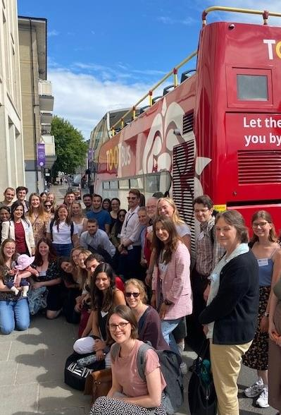
Projects will be automatically rejected if they do not meet the following essential criteria:
Feasibility of project resourcing arrangements – MRC funding guidelines prevent us from supporting project consumable costs. We have to ensure that projects will be adequately resourced.
Evidence to support awareness of the importance of equality, diversity and inclusion – the DTP fosters an ethos of EDI at all stages of recruitment, training and student support.
Quality of the research environment including PhD completions across the supervisory team in the last 10 years.
Projects will also be rejected if they do not fit within our remit to ensure an optimal student experience
Project Selection Criteria

Slide 19
Student Selection Criteria
Application shortlisting
Proven academic quality
Research potential
Personal motivation & commitment
At interview
Critical thinking
Fit with project
Personal motivation & commitment

Slide 20
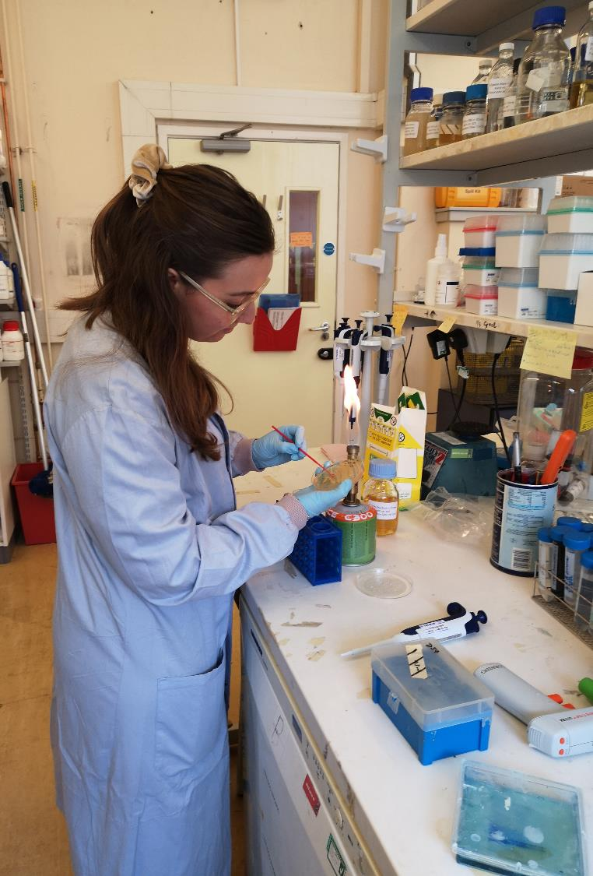
Our Students
Registered at HEI of lead supervisor
Students welcomed from non-bioscience backgrounds across themes
Core skills training, appraisal, monitoring and pastoral support
Provided in the first instance by the PGR office at the home institution and enhanced by GW4 BioMed2 MRC DTP
Support for travel to other HEIs and training events
Cohort building, peer-led training

Slide 21
Attracting Applications
Attracting Applications
Applicants may use the titles of projects alone as a screening tool.
Therefore, it is very important to craft the wording of your project title at a level appropriate for an applicant who is not yet an expert in the field.
Consider the same for your project summary, which is used to advertise the project. Is it written using accessible language that would interest a student applicant?
Ask your PGT and PGR students, ECR researchers and other colleagues if they understand your project.
We advertise the successful projects on FindaPhD, your university website, the DTP website and X, but use your own contacts to spread the word. This could include contacting relevant Masters students at your institution or using your own social media channels.
Understanding and disrupting holobiont integrity in mucormycosis
Looking for an Achilles Heel in the deadly fungi that causes mucormycosis

Slide 22
PIs can only be lead supervisor on one project each year.
PIs can only be lead supervisor on projects in two of any three-year rolling period.
PIs can be a co-supervisor on an unlimited number of projects.
Competitive “flexible” fund available for “additional training costs” e.g. high-cost training, exceptional training opportunities, placements, transfer to post-docs once the studentship commences.
Project costs and ongoing consumables are NOT funded by the DTP and should be supported by the PI/co-supervisors.
Detail high-cost training essential for the project eligible for a one-off payment from the DTP, e.g. in vivo costs, database access charges, large data storage. Note that this funding is ONLY available at at the start of the project.
iCase and iCASE conversion opportunities are available
FAQs

Slide 23
Next Steps
Project proposals must be submitted using the online survey available on the DTP website from Wednesday 4th June 2025
The closing date for project applications is 5pm on Friday 11th July 2025.
Please read the full FAQ document available on the DTP website or request a copy of the information by contacting GW4BioMed@Cardiff.ac.uk before applying
Raise awareness of the DTP with potential PGR students
Volunteer as a student application marker!

Slide 24
Contact Details
Role | Contact
Director | Professor Emma Kidd | kiddej@cardiff.ac.uk
Director of Research Culture & Wellbeing | Dr Giovanni Biglino | g.biglino@bristol.ac.uk
Bath Academic Leads | Dr Kate Button Dr Julien Licchesi | kn658@bath.ac.uk jdfl20@bath.ac.uk
Bristol Academic Leads | Professor David Sheppard Professor Matthew Avison | D.N.Sheppard@Bristol.ac.uk Matthewb.avison@bristol.ac.uk
Cardiff Academic Leads | Dr David Petrik Dr Neil Rodrigues | petrikd@cardiff.ac.uk rodriguesn@cardiff.ac.uk
Exeter Academic Leads | Professor Wendy Noble Dr Emma Dempster | w.noble2@exeter.ac.uk e.l.dempster@exeter.ac.uk
Infection, Immunity, Antibiotic Resistance and Repair Theme Leads | Position Vacant Dr Martin Eichmann | M.Eichmann@exeter.ac.uk
Neuroscience and Mental Health Theme Leads | Dr Esther Walton Dr Emma Dempster | E.Walton@bath.ac.uk e.l.dempster@exeter.ac.uk
Population Health Sciences Theme Leads | Position Vacant Dr Jon Heron | jon.heron@bristol.ac.uk
DTP Hub | Erica Lewis – Centre Manager | gw4biomed@cardiff.ac.uk

